Slide 1
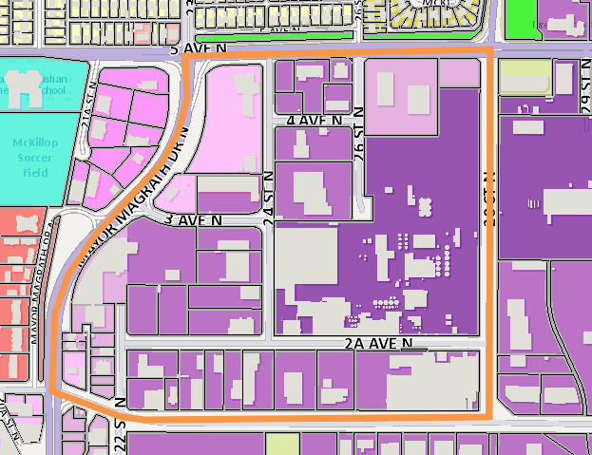
Land Use Bylaw Renewal Project
Translating Planning Theory to Planning Practice
Authors: Hannah Laberge & Brie Wilson
Faculty Supervisor: Lars Hallstrom City Supervisors: Ross Kilgour & Genesis Molesky
Methods
Strial Business
Introduction
Results
The Land Use Bylaw (LUB) Renewal Project aims to restructure the LUB to meet changing community needs and the objectives of the Municipal Development Plan, creating a less restrictive LUB that is conducive to a healthy and sustainable community.
This applied study is a preliminary step to address issues in commercial and industrial districts. This project examines the LUB concerning land provision, allowable uses, and community needs by engaging with planners and academic literature.
We synthesized City planner feedback to develop criteria to help streamline land use districts and uses employing the following process:
Phase One: Engagement
1. Engagement: Students engaged with the City of Lethbridge's Planning and Design Department to record the prominent issues and opportunities in the LUB.
2. Consolidation: Engagement was translated into actionable changes to the LUB (see Fig. 1).
Phase Two: Analyzing land use district compliance and uses under the current LUB and the proposed LUB (based on the engagement session)
1. Sampling: Purposive sampling was used to select an area based on the engagement feedback, proximity to residential developments, and mixture of districts (see Fig. 2) to exemplify the proposed changes to the LUB.
2. Data Organization: Data was organized and collected. Collected data includes address, current owner, proposed district zoning, permitted or discretionary use, and compliance with proposed LUB changes.
3. Reporting: Results were summarized. The data collection and consolidation process was systemized for future applied studies.
Fig. 1. Issues identified during planner engagement and corresponding proposed changes to the LUB.
LUB recommendations | Proposed change to the LUB
Accommodating and responding to industry needs and trends. | Reconsider parking requirements to allow for flexible responses to automation, AI, and increased multimodality. Remove unnecessary restrictions on building size and form.
Efficient commercial and industrial land utilization. Increasing employment density. Supporting industrial workers. | Delineating between commercial and industrial uses while permitting industrial support services in industrial districts. Combining commercial districts to streamline the redevelopment permit process.
Managing environmental, economic, and community health. | The LUB can mitigate concerns and promote economic growth by collapsing general and business industrial districts and maintaining heavy industrial districts with landscape buffers.
Facilitating land ownership opportunities. Generating community buy-in. | Allowing smaller parcels and mixed-residential and commercial uses allows smaller businesses to purchase land.
Background
Fig. 2. Map of study area, Lethbridge, Alberta.
The business and industrial community has identified land scarcity as a critical issue.
The LUB currently separates industrial land into three districts with overlapping definitions.
Consolidation efforts should consider simplifying districts and land uses while mitigating industrial land price inflation and inappropriate redevelopment.
Legend
Buildings
.
Heavy Industrial (I-H)
.
General Industrial (I-B)
.
Industrial Business (I-B)
.
General Commercial (C-G)
.
Local Commercial (C-L)
.
Low Density Residential (R-L)
.
Mixed Use Residential (R-M)
.
Public Building (P-B)
.
Parks and Recreation (P-R)
.
Study Area Boundary
Analysis
Challenges to Effective Implementation of the renewed LUB​
The Five I's of implementation (adapted from Nussbaum and Spessot, 2017):​
1. Influence: Unequal access to knowledge and representation sways urban policy outcomes.​
2. Inertia: Existing urban morphology can slow change and obscure objectives.​
3. Illiteracy: Communication must align with residents' identities to convey anticipated outcomes effectively.​
4. Inconsistency: Unique city contexts require clear communication to ensure the relevance of planning advice.​
5. Interference: Political influences may obstruct best practices, necessitating senior management's role in safeguarding staff independence (Faludi, 1973).
Considerations for the renewed LUB:
The knowledge-practice gap in planning education
Planning education often relies on random knowledge dissemination through various channels, often divorced from academic planning theory, decreasing policy efficiency (Alexander, 2010).
To bridge the theory-practice gap in the planning discipline, Moroni (2010) advocates for an ethics-driven framework strengthened by collaboration between theorists and practitioners for effective implementation.
Objective
To synthesize the best practices denoted in the decoding papers, academic literature, and theory to create a tool that examines the effects of consolidating business and industrial districts to improve planning policy implementation.
Conclusion
Urban growth and competition: Several municipalities want to use thier LUBs to build social capital and support commercial innovation.
References
Community context and stakeholder engagement: It is crucial to address our unique community context and effectively engage with residents, business owners, developers, and Indigenous communities.​
Alexander, E. R. (2010). Introduction: Does planning theory affect practice, and if so, how?. Planning Theory, 9(2), 99-107. https://doi.org/10.1177/1473095209357862
Faludi, A. (1973). A reader in planning theory ([1st]. -- ed., Vol. 5). Pergamon Press. https://go.exlibris.link/XkvPFww0
Moroni, S. (2010). Rethinking the theory and practice of land-use regulation: Towards nomocracy. Planning theory, 9(2), 137-155. https://doi.org/10.1177/1473095209357868
Nussbaum, T., & Spessot, M. (2019, July 24). The five I’s of failed urban planning. Policy Options. https://policyoptions.irpp.org/magazines/november-2017/the-five-is-of-failed-urban-planning/
Challenges in perception and implementation: The existing urban form and traditional planning legacies influence public perception of new policies, challenging the implementation of the renewed LUB. ​
Recommendations for improved engagement: Diverse data collection, education, and engagement strategies can help overcome these challenges and foster productive community involvement.​
Notes:
Who: Planning and development department, local businesses, business/ industrial sector
What: The Land Use Bylaw (LUB) renewal project aims to restructure the LUB to meet changing community need and the objectives of the Municipal Development Plan, with the goal to be less restrictive and shape the kind of communities Lethbridge citizens want to live, visit, and do business in.
Where: the City of Lethbridge
When: the process will take place from 2023-2026
How: by engaging with the theory, literature, etc. and city planners to determine the city’s ideas to make business easier
Why: to make the City less restrictive and shape the kind of communities Lethbridge citizens want to live, visit, and do business in.

