Slide 1
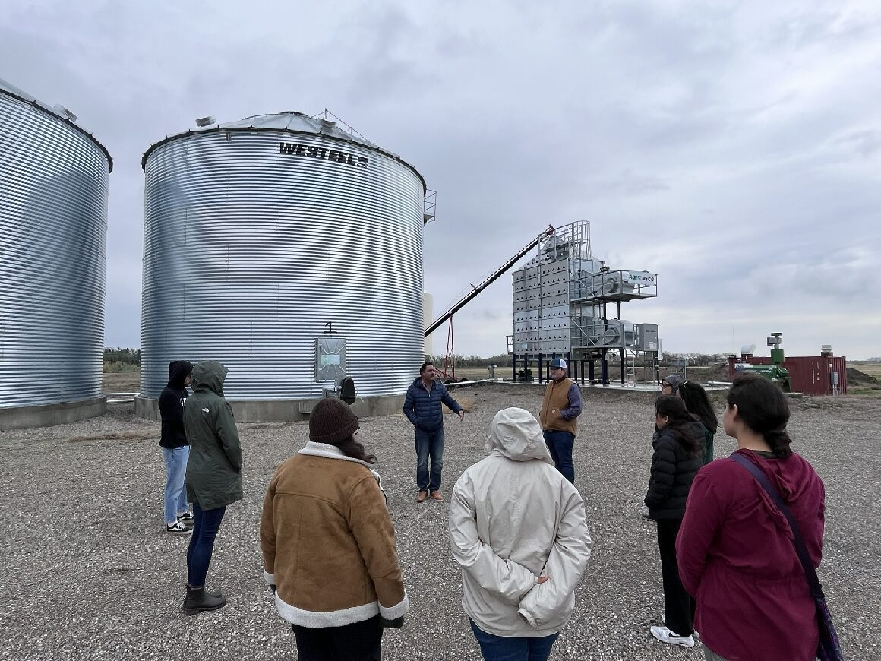
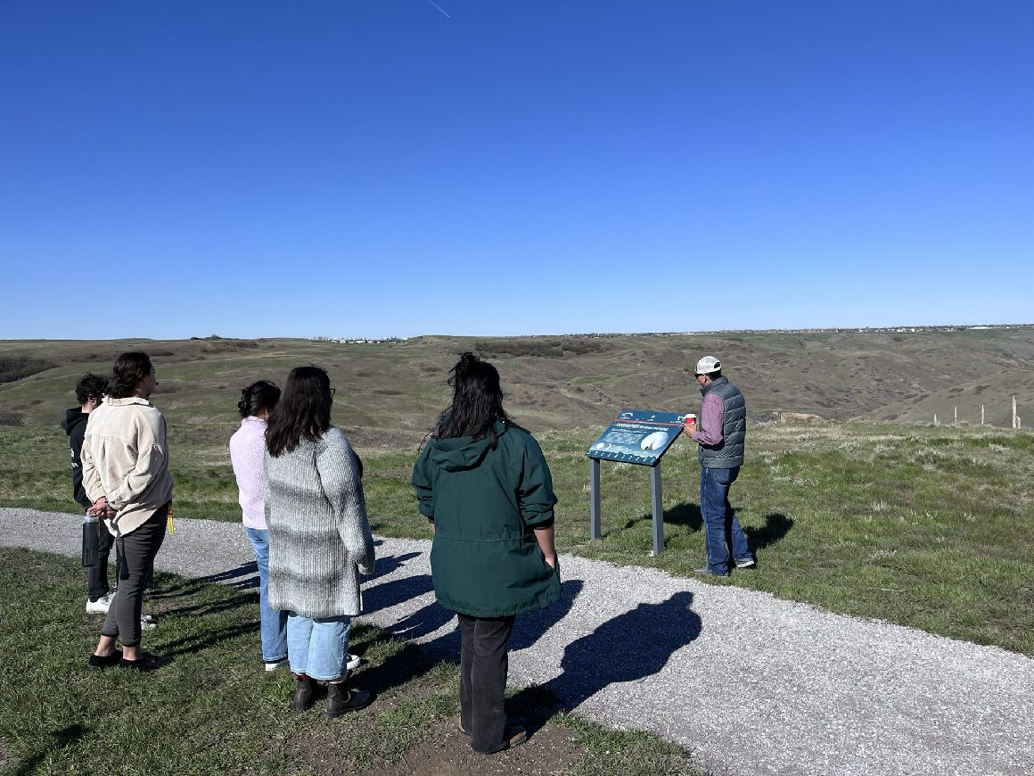
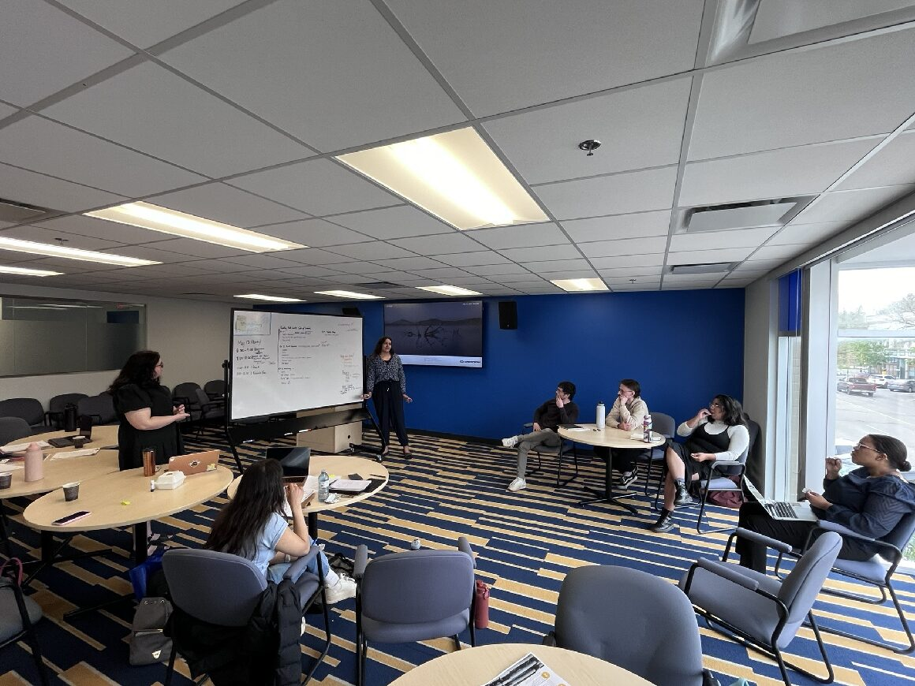
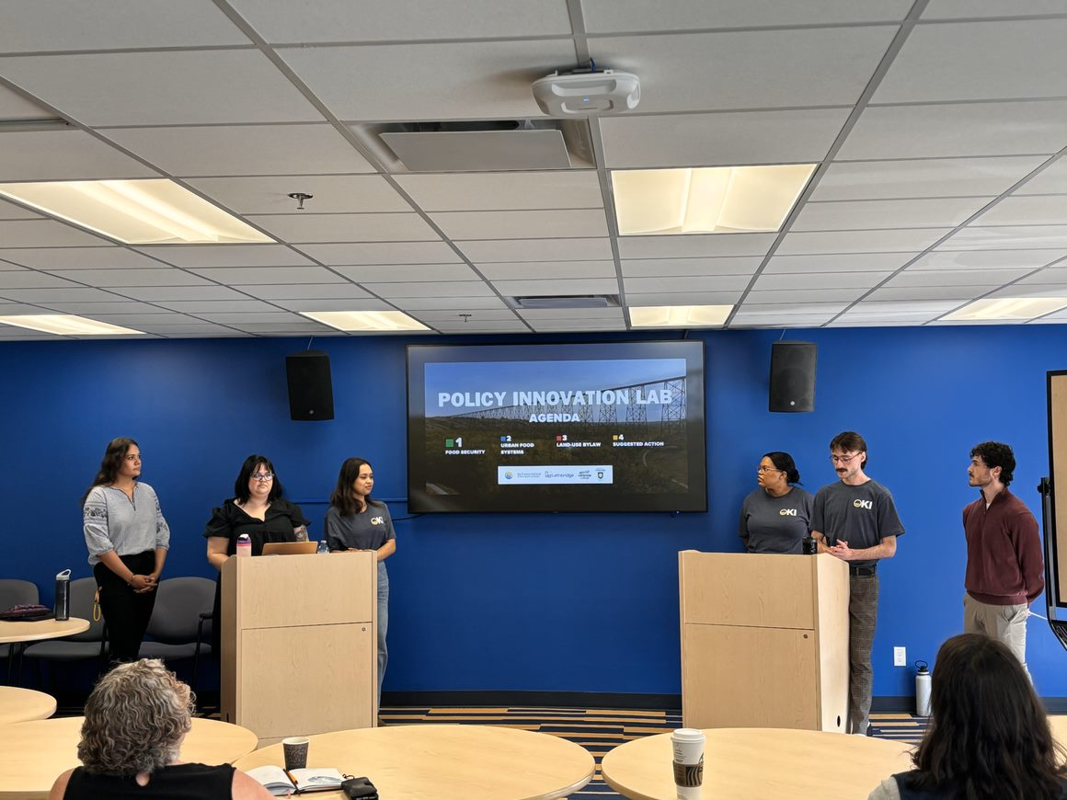
The 2024 Policy Innovation Lab: Urban Food Security and Land Use Policy
Erica Gonzalez B.A., Graduate Research Assistant, Prentice Institute, University of Lethbridge
Andrea Cuellar Ph.D., Associate Director, Prentice Institute, University of Lethbridge
Perry Stein M.A., RPP, Partner Services Manager, City of Lethbridge
Overview
PIL Structure
Results
Deliverables:
The Policy Innovation Lab (PIL) is an interinstitutional collaboration between the City of Lethbridge, the Prentice Institute, and Lethbridge Polytechnic to address the topic of urban food insecurity and municipal land use in Lethbridge.
Developed as a new model for Work Integrated Learning (WIL), the PIL empowers students to engage in civic decision-making by working on current municipal policy projects.
In May 2024, six undergraduate students participated in a four-week program to examine and propose policies to enhance food security in Lethbridge through the Land Use Bylaw (LUB) renewal project.
Part A: Seminar Series
Two weeks of seminars from knowledge holders to build a knowledge foundation.
Students participated in 16 seminars, including a coulee walk to learn the Blackfoot perspective on food and a visit to the local food bank.
Part B: Research and Deliverables
Students received two weeks to brainstorm collaboratively and to find directions for their policy recommendations.
Students produce two presentations outlining the topic and their policy recommendations.
The presentation was later used to produce a technical report.
After PIL completion, students were given an evaluation survey for feedback.
All participating students found the PIL to be:
A rewarding experience personally and professionally.
Valuable for expanding their understanding of food insecurity and the municipal policy process.
Most participating students found:
Engaging with knowledge holders as valuable for shaping the final presentation and outcomes
The experience increased their likelihood of remaining in Lethbridge after the city.
Some participating students found:
The PIL somewhat addressed the topic meaningfully.
Background
Discussions
Using the ongoing City's Land Use Bylaw (LUB) renewal project as a framework, the PIL cohort examined policy interventions to tackle urban food security.
The project had several objectives:
Better understand the underlying structural factors of food insecurity within Lethbridge.
Grow the City’s ability to access knowledge and skills to help navigate complex policy issues.
Mobilizing academic expertise and research capacity to impact our immediate communities positively.
Facilitate hands-on work experience for students in a municipal policy setting.
To train and retain student talent and knowledge.
During the pilot run, the PIL achieved many of its goal including providing:
Students with hands-on work experience in a municipal policy setting and increasing student retention.
The foundation to explore the underlying structural factors of food insecurity within Lethbridge through the technical repot.
Students access to community perspectives through knowledge holders allowing students to engage in research that will positively affect our immediate communities.
Acknowledgement
Photos: Tour of Lethbridge Polytechnical farm (Upper-left); Coulee walk with Blackfoot Elders (Upper-right); Students brainstorming policy recommendation (Lower-left); Final student presentation (Left-right).
The PIL is supported by the University of Lethbridge SSHRC Explore grant through the Prentice Institute.​

