Slide 1
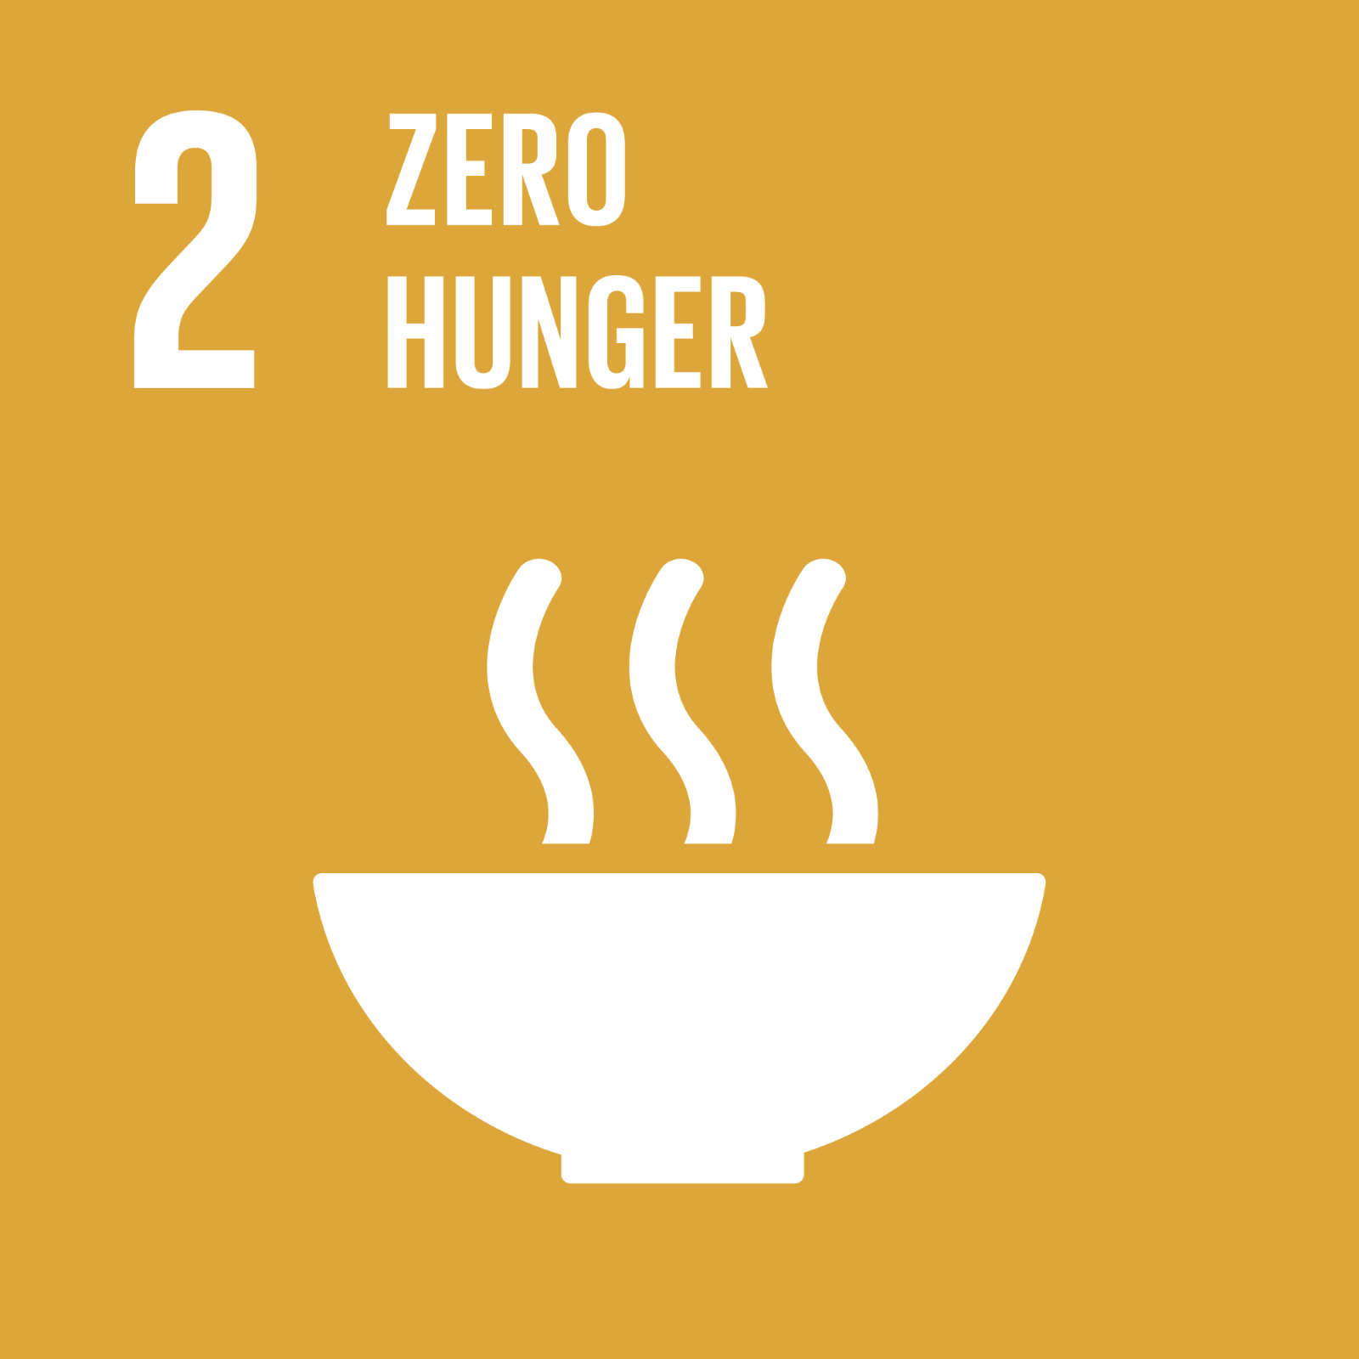
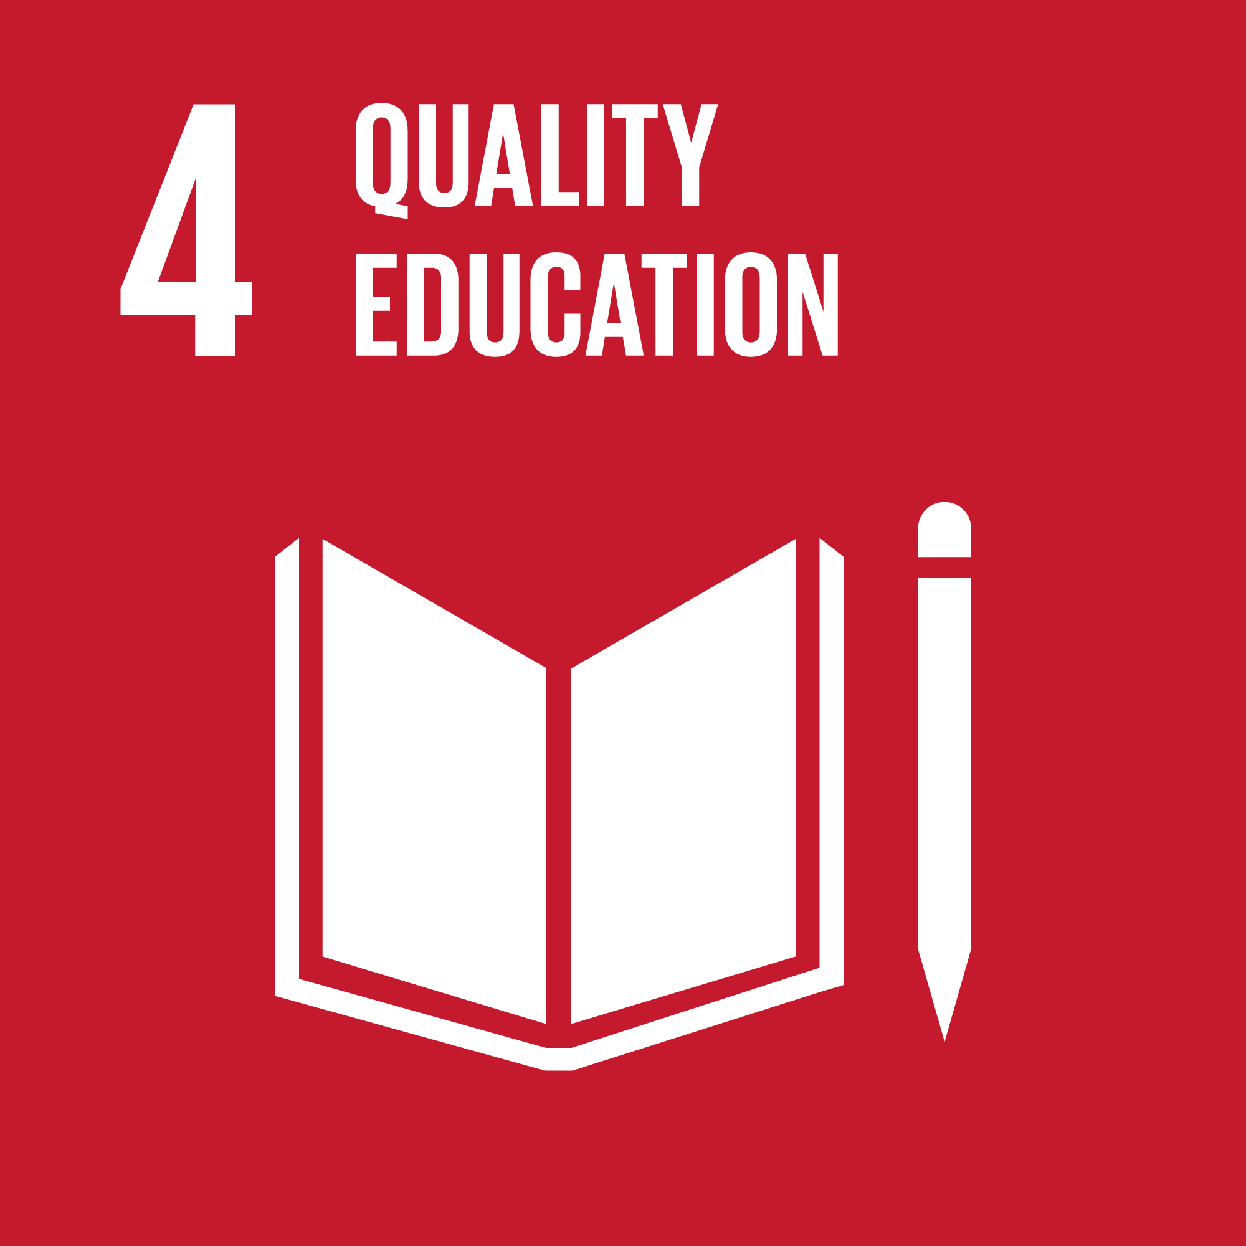
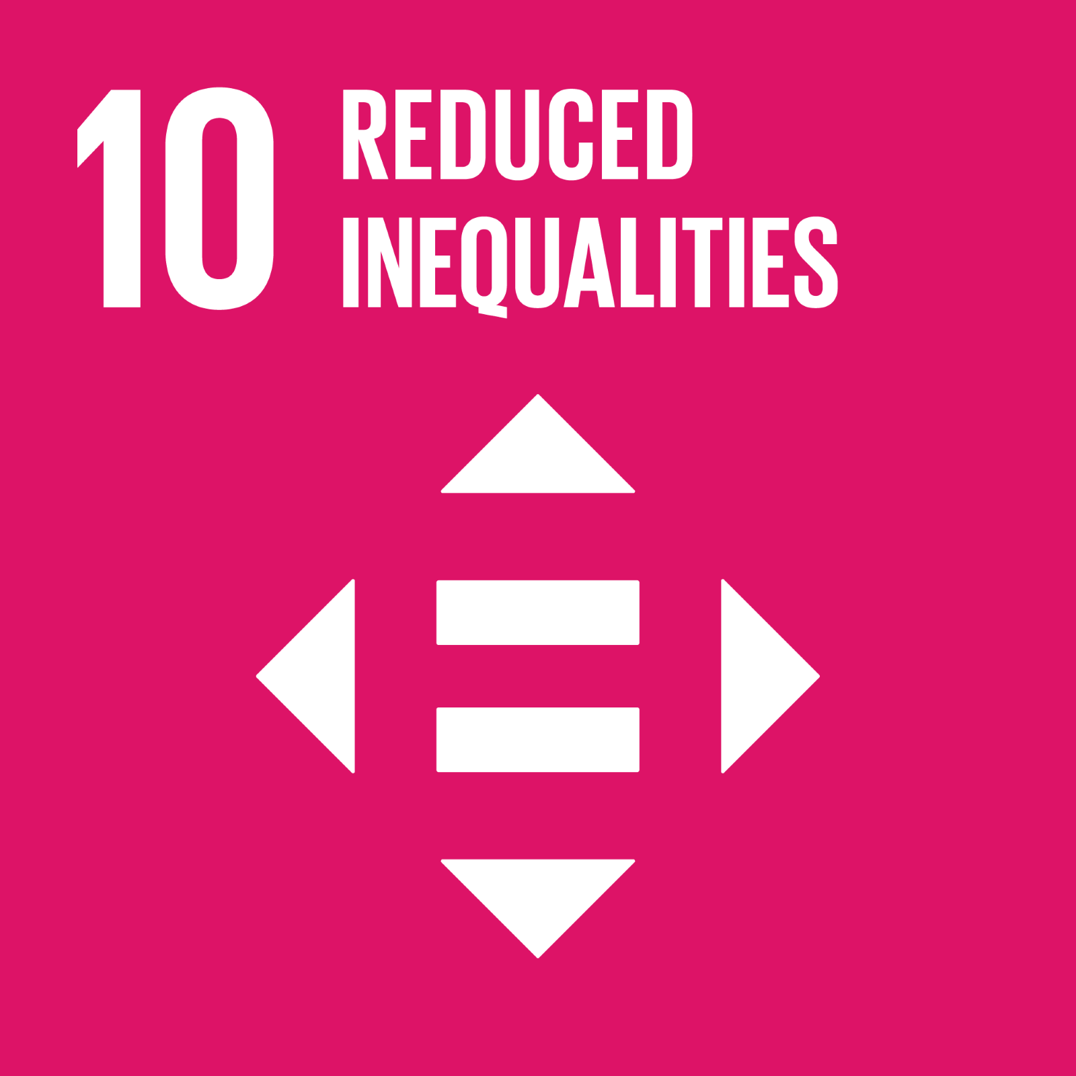
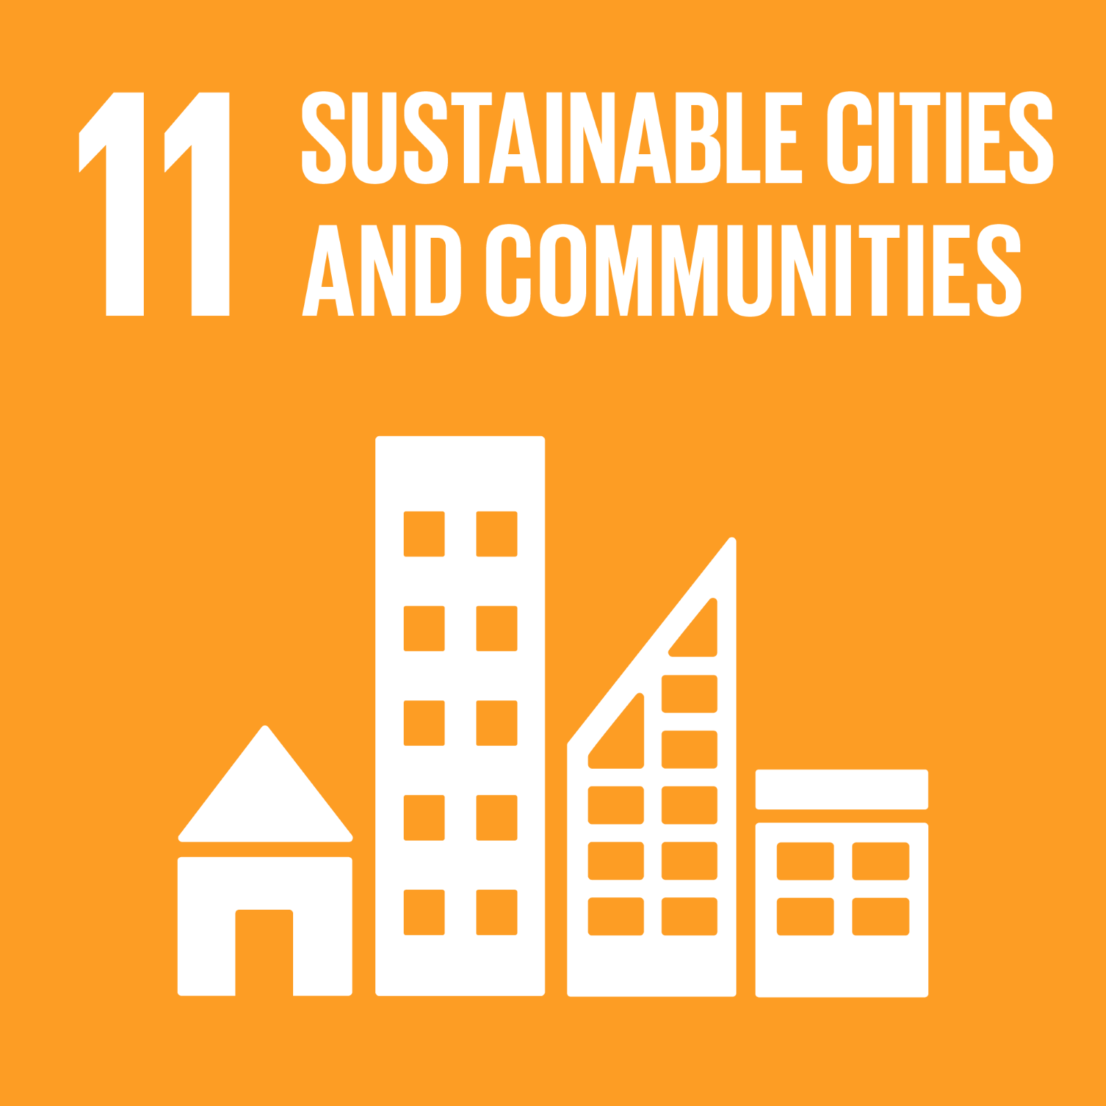
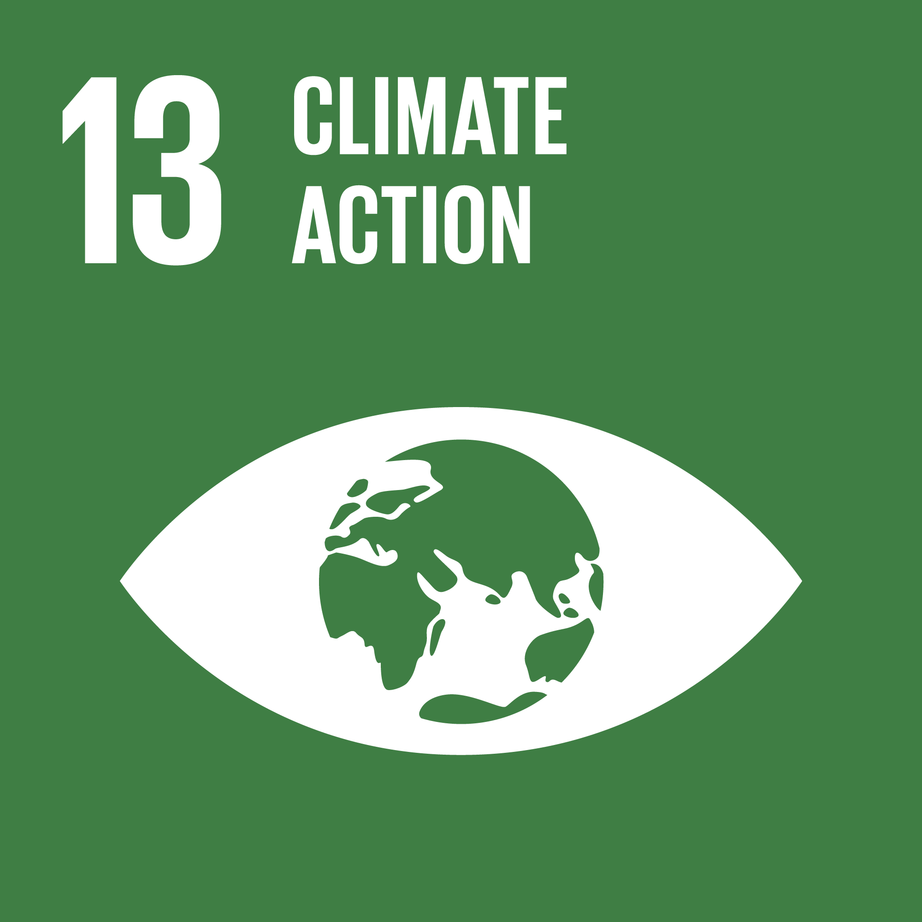
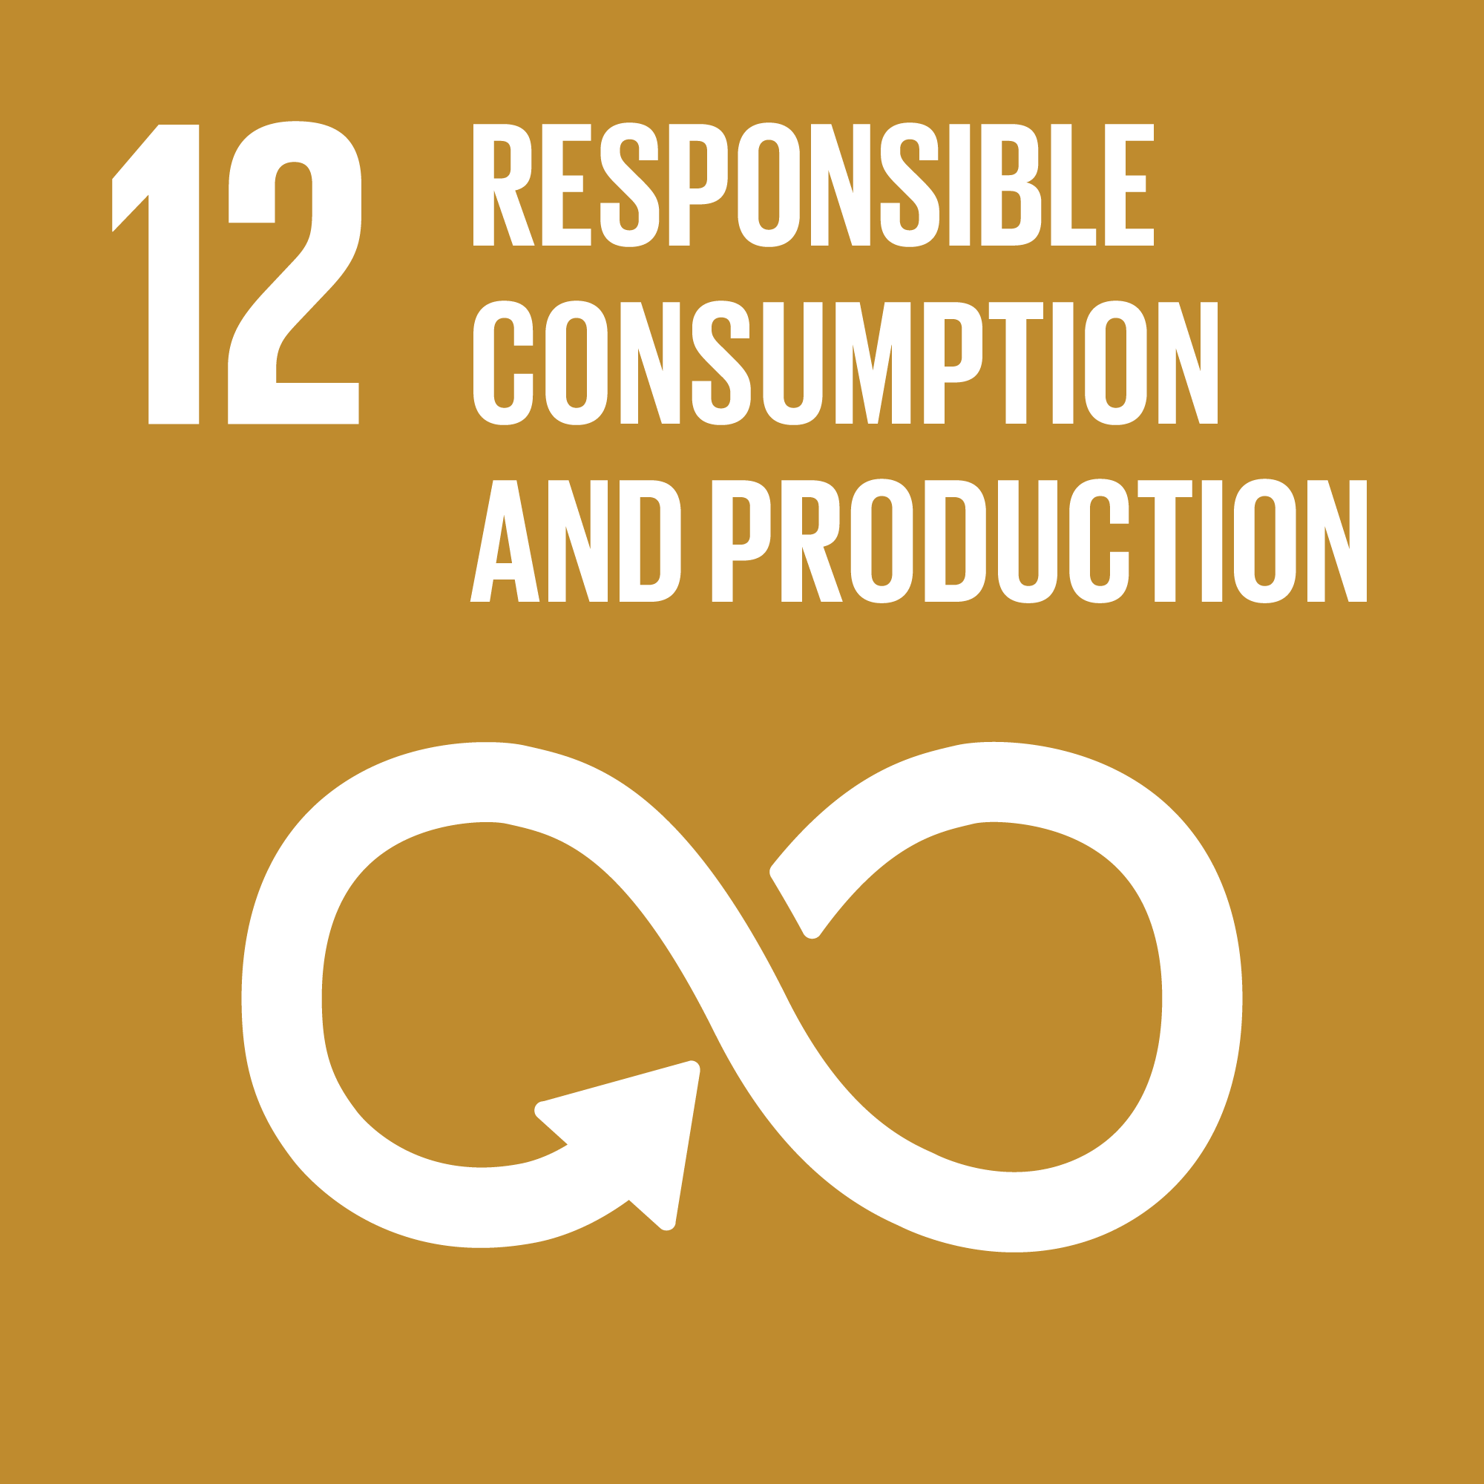
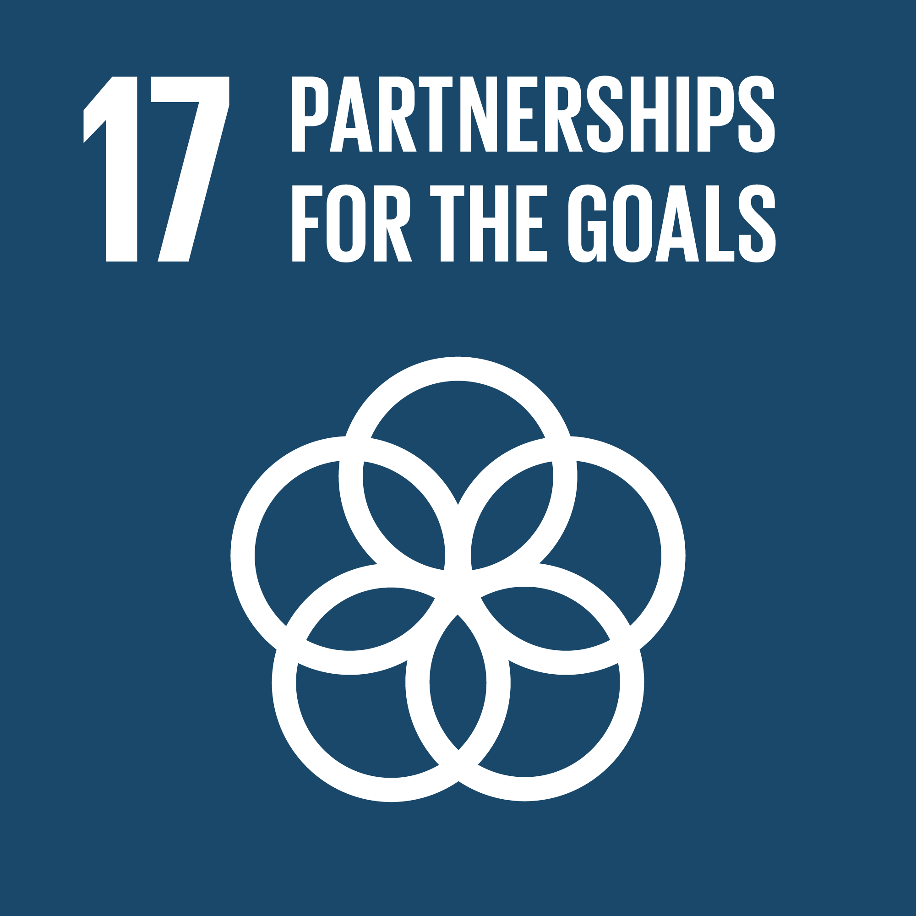
The 2024 Policy Innovation Lab: Urban Food Security and Land Use Policy
Erica Gonzalez B.A., Graduate Research Assistant, Prentice Institute, University of Lethbridge
Andrea Cuellar Ph.D., Associate Director, Prentice Institute, University of Lethbridge
Perry Stein M.A., RPP, Partner Services Manager, City of Lethbridge
Overview
Objectives
Key Concepts
The Policy Innovation Lab (PIL) is an interinstitutional collaboration between the City of Lethbridge, the Prentice Institute, and the Lethbridge College to address shared challenges within the city. By involving students in ongoing municipal policy projects, the PIL aims to develop a new Work Integrated Learning model.
In 2024, the PIL will focus on Urban Food Security and Land Use Policy. During the pilot year, six undergraduate students will participate in a four-week program to examine and propose policies to enhance food security in Lethbridge.. Their work will inform the city's Land Use Bylaw (LUB) renewal project.
The PIL is supported by the University of Lethbridge SSHRC Explore grant through the Prentice Institute.
Shared Objectives:
Better understand the underlying structural factors of food insecurity within Lethbridge.
Strengthening interinstitutional partnerships to understand and respond to shared challenges.
Facilitating work experience and professional development opportunities for students.
Students:
Gaining hands-on experience in a municipal policy setting and professional development.
Transferring academic experience into a professional setting.
Post-secondary Institutions:
Exploring new models of Work Integrated Learning.
Mobilizing academic expertise and research capacity to impact our immediate communities positively.
City of Lethbridge:
Growing its ability to access knowledge and skills to help navigate complex policy issues.
Training and retaining students, talent and knowledge.
The PIL adopts a collaborative and inclusive knowledge model:
Communities of Practice (CoPs):
Challenge the existing power structures around knowledge production and producers.
Empower students as subject-matter experts.
IDEA (inclusion, diversity, equity, and access) framework:
Promotes participation from students with diverse academic backgrounds and life experiences to engage the subject matter with an equity-forward lens.
Constructivist Learning Theory:
Acknowledges the best learning is collaborative and aware of the social context of knowledge production.
Supports reflexive practices and student agency.
Hands-on Learning:
Empowers students to apply academic skills and lived experience to a practical, results-oriented purpose in a professional setting.
Background
The emergence of cities as nodes for new food governance systems opens possibilities for policy innovation.
Using the ongoing City's Land Use Bylaw (LUB) renewal project as a framework, the PIL will examine possible municipal policy interventions to tackle urban food security.
The PIL will examine urban food (in)security by focusing on structural factors and applying an equity framework to land use. This approach offers an alternative to traditional "alleviation" mechanisms.
The PIL contextualizes urban food security under the UN Sustainable Development Goals using a systems thinking approach in its instructional content and development.
References
Andrée, P., Ballamingie, P., & Coulas, M. (2021). Integrative governance for ecological public health: An analysis of ‘Food Policy for Canada’(2015-2019). Canadian Food Studies/La Revue canadienne des études sur l'alimentation, 8(2), 189-226.
Ballamingie, P., Blay-Palmer, A., Knezevic, I., Lacerda, A., Nimmo, E., Stahlbrand, L., & Ayalon, R. (2020). Integrating a food systems lens into discussions of urban resilience: A policy analysis. Journal of Agriculture, Food Systems, and Community Development, 9(3), 227-243.
Peterson, N. D., & Freidus, A. (2023). University Student Food Insecurity as a Form of Structural Violence. Human Organization, 82(2), 182-194.
Polman, D., & Bazzan, G. (2023). Governance tools for urban food system policy innovations in the Milano Urban Food Policy Pact. European Urban and Regional Studies, 30(4).
UN Sustainable Development Goals related to the PIL.

