Slide 1
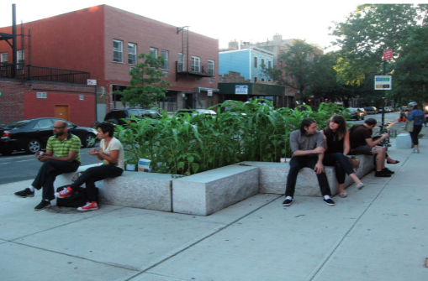
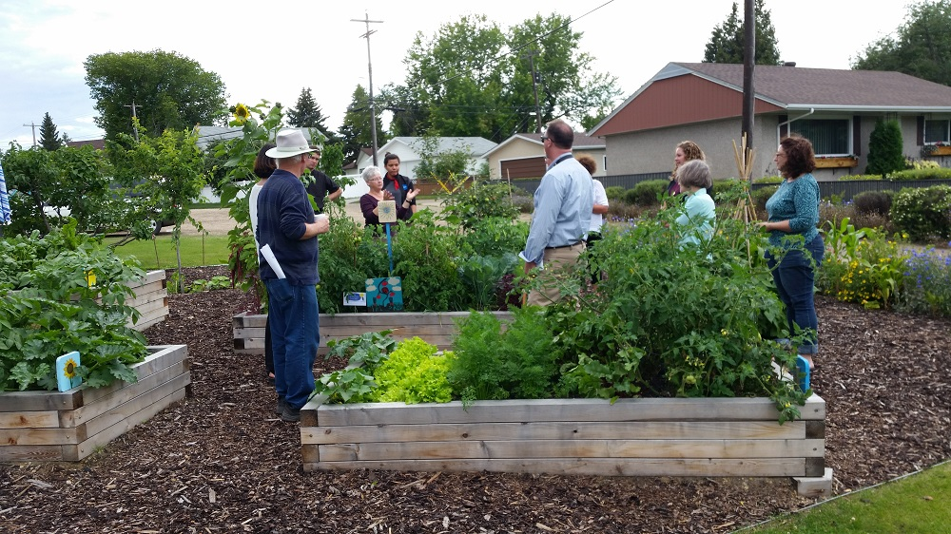
Urban Food Security and Land Use Bylaw Renewal Project
Erica Gonzalez^{1,3}, Bhawana Pradhan^{1,3}, Breanna Little Mustache^{1,3}, Brie Wilson^{1 ,3}, Bruce Ascione ^{2,3}, JD Gervais^{2,3}, Amy-Lee Lateeph^{2,3}
¹ Prentice Institute for Global Population and Economy, University of Lethbridge; ² Lethbridge Polytechnic, ³ City of Lethbridge ⁴
Overview
Report Findings
Recommendations
During the 2024 Policy Innovation Lab (PIL), students examined policy approaches to improve food security (FS) in Lethbridge through the Land Use Bylaw (LUB) renewal project.
High food insecurity (FIS) rates have been impacting people across Canada (Li et al., 2023). During the City of Lethbridge's needs assessment to inform future policy, FS was commonly seen as a concern for students and the community. In response, the PIL's student participants were tasked with providing policy recommendations for the LUB and a report on FIS to the city.
Across Canadian municipalities, Urban Agriculture (UA) has been implemented in support of FS initiatives and foster equitable food system. The report highlights the following:
Lack of Data
There is currently limited data on the impacts of FIS in the CoL.
LUB Recommendations
To support UA initiatives, the LUB should establish clear definitions for UA activities.
The CoL may consider the incorporation of UA within land-use districts to promote resident involvement.
Streamline applications and permits for UA initiatives to boost community engagement.
Raising Awareness of FS
Public art installations can creatively highlight issues with local FS and potential UA projects.
Planning Recommendations
Broaden land-use definitions to include community gardens, green roofs, etc.
Increase mixed-use zones and form-based codes to support local food systems.
Streamline applications for UA projects.
Research Recommendations
Evaluate the prevalence and impact of FIS in Lethbridge.
Develop a standardized evaluation for UA initiatives.
Policy Recommendations
Form a food council and explore interdepartmental policies addressing FIS.
Explore tax incentives to promote UA on underused land.
Partner with local organizations to raise awareness for FIS via public art and community dialogue.
What is the PIL?
The PIL is a collaboration with the City of Lethbridge (CoL), the Prentice Institute (PI), and Lethbridge Polytechnical (LP).
Designed as a work-integrated learning (WIL) program, the PIL is geared towards training students in the municipal planning policy process. Primarily, by providing students with the opportunity to relevant community concerns such as FS.
In a four-week work-integrated learning (WIL) initiative, six undergraduate students examined potential amendments to the Land-Use Bylaw (LUB) to support urban food security (FS) and produced recommendations for the City of Lethbridge (CoL).
Acknowledgements
Supervision for the PIL is provided by Perry Stein, MA RPP MCIP⁴ , Dr. Andrea Cuellar^{1,2} & Dr. Michael Granzow³.​
References
Christina Kelly. (n.d). Maize Field. https://www.discobikini.com/maize-field/
City of Edmonton. (n.d). Pop-up community gardens program.https://www.edmonton.ca/programs_services/landscaping_gardening/pop-up-community-gardens .
Li, T., Fafard St-Germain, A., & Tarasuk , V. (2023). Household food insecurity in Canada, 2022. Toronto: Research to identify policy options to reduce food insecurity (PROOF). https://proof.utoronto.ca/
Photos: Maize Field by Christina Kelly in Brooklyn (left); Edmonton's Pop-Up Community Gardens (Right)

